Slide 1
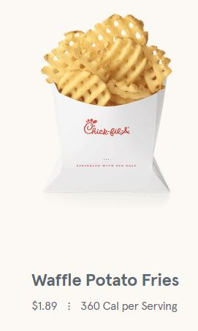
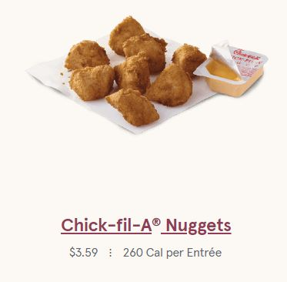
Please grab a chromebook and have out “Healthy Animals.” If you haven’t finished, work on doing that now.
It should be in your individual portfolio.
Notes:
Have students determine in groups of 2-3.
Add combinations (with cost) to board.

Slide 2
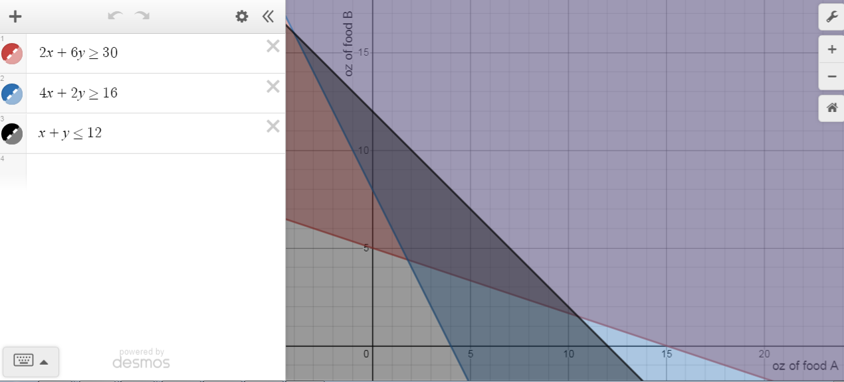
Healthy Animals

Slide 3
Your table has $20 to spend.
How much can you buy?
Come up with 2-3 options.
Notes:
Have students determine in groups of 2-3.
Add combinations (with cost) to board.

Slide 4
Vocabulary
Constraint--limitation (represented with inequalities)
Feasible region--area of possible solutions (shaded area)

Slide 5
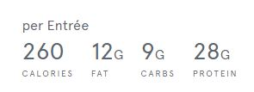
I want to avoid being hungry later...
What if I want to maximize or minimize the number of calories, fat, protein, or carbs? How do I calculate that, assuming that we still have $20?
Notes:
Create equation.
Discuss feasible region.

Slide 6
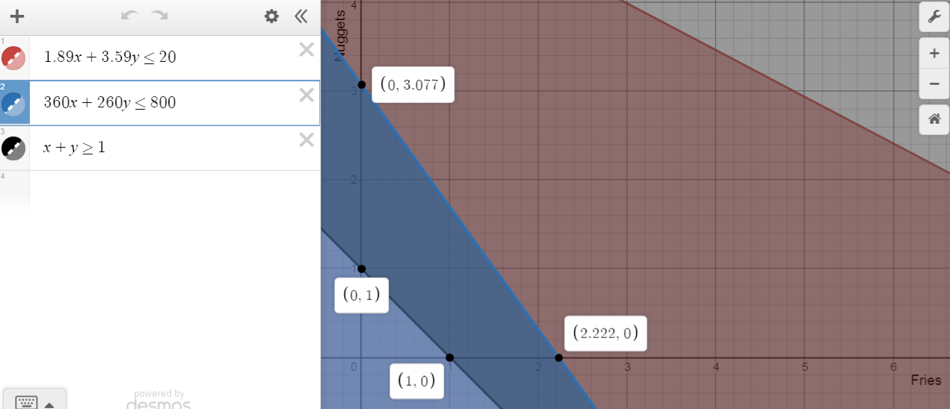

Slide 7
More Vocabulary
Optimization--seeking the maximum or minimum
Objective function--the function that we want to maximize or minimize
Vertex (or vertices)--where the lines touch
*Use the vertices of the feasible region to optimize!*

Slide 8
Each week, Carly can make 10 to 25 necklaces and 15 to 40 pairs of earrings. She earns profits of $3 on each pair of earrings and $5 on each necklace. From past sales, she anticipates selling at least 30 pieces of jewelry. How can she maximize profit?

Slide 9
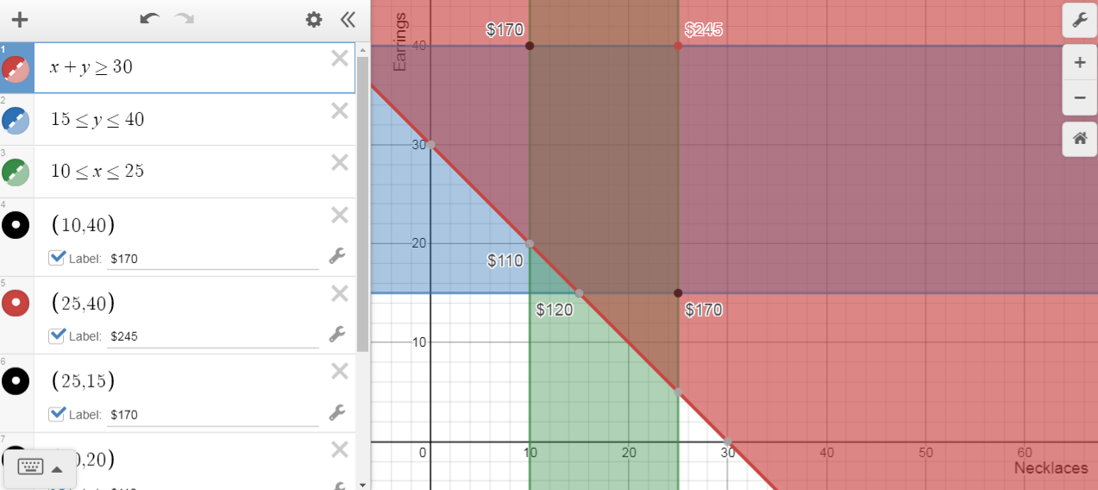

Slide 10
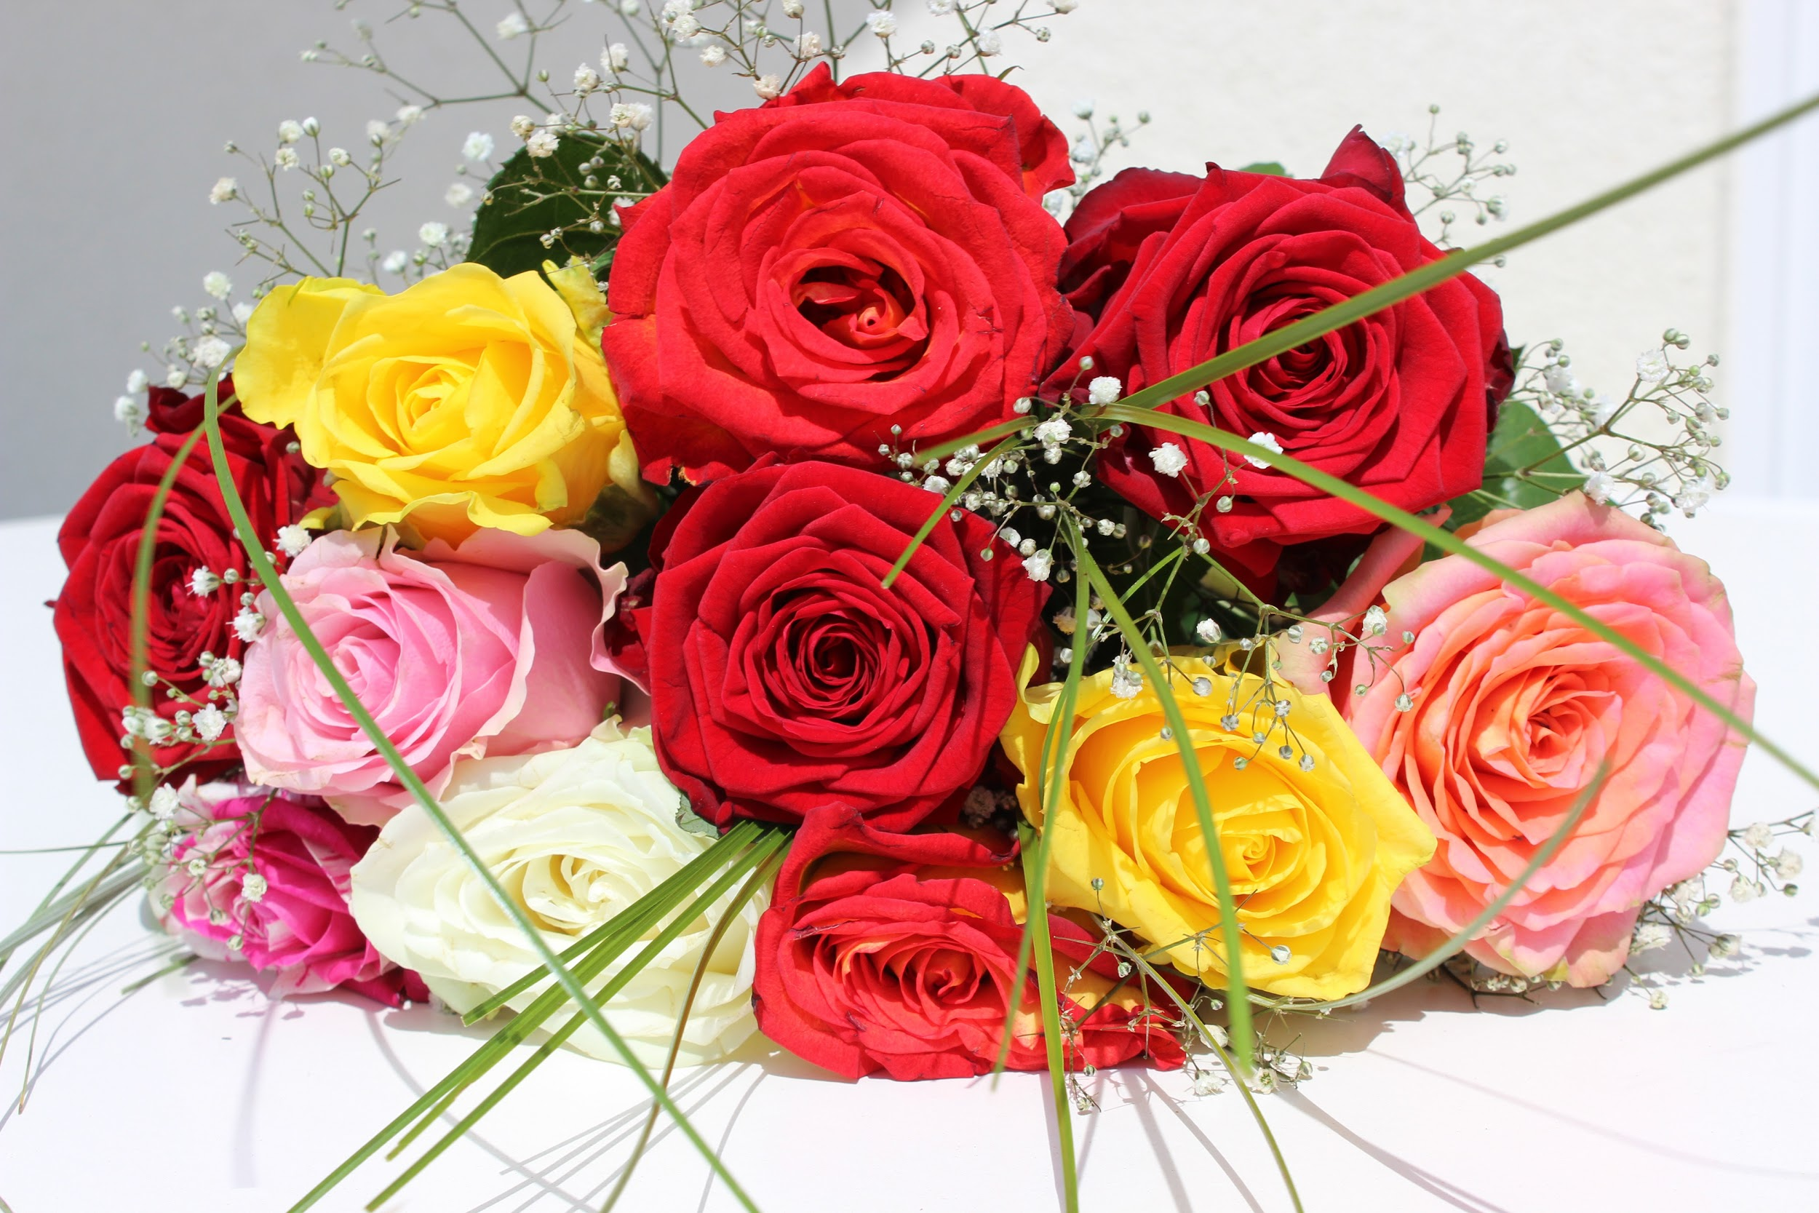
Let’s Revisit The Bouquet
Alex is ordering his girlfriend a bouquet of flowers to give her when he asks her to prom. Roses cost $5 each and carnations cost $2 each. He would like to include at least 3 flowers. To stay in his budget, he must not spend more than $36.
He wants to include at least 1 of each type of flower.

Slide 11
Parking Lot
The area of a parking lot is 600 square meters. A car requires 6 square meters. A bus requires 30 square meters. The attendant can handle only 60 vehicles. If a car is charged $2.50 and a bus $7.50, how many of each should be accepted to maximize income?

Slide 12
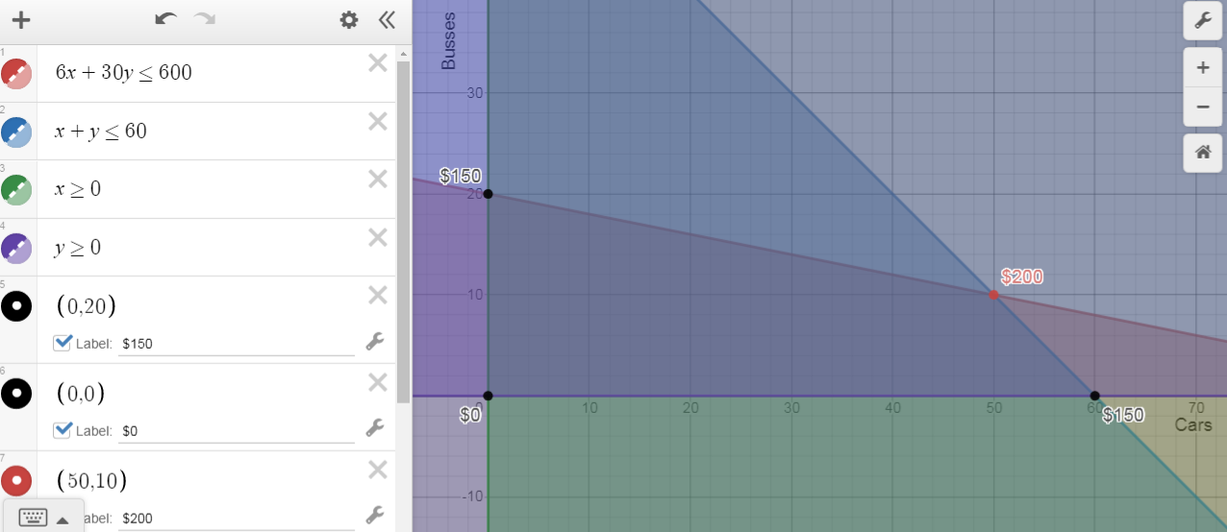

Slide 13
Toy Factory
Toys-A-Go makes toys at Plant A and Plant B. Plant A needs to make a minimum of 1000 toy dump trucks and fire engines. Plant B needs to make a minimum of 800 toy dump trucks and fire engines. Plant A can make 10 toy dump trucks and 5 toy fire engines per hour. Plant B can produce 5 toy dump trucks and 15 toy fire engines per hour. It costs $30 per hour to produce toy dump trucks and $35 per hour to operate produce toy fire engines. How many hours should be spent on each toy in order to minimize cost? What is the minimum cost?

Slide 14
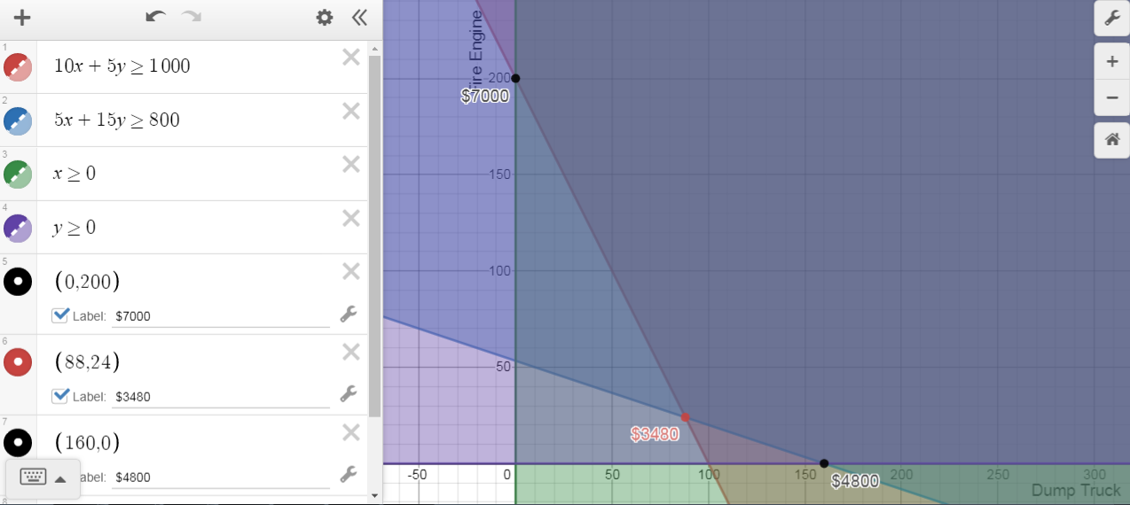

Slide 15
Vitamins
A diet is to include at least 140 milligrams of Vitamin A and at least 145 milligrams of Vitamin B. These requirements can be obtained from two types of food. Type X contains 10 milligrams of Vitamin A and 20 milligrams of Vitamin B per pound. Type Y contains 30 milligrams of Vitamin A and 15 milligrams of Vitamin B per pound. If type X food costs $12 per pound and type Y food costs $8 per pound how many pounds of each type of food should be purchased to satisfy the requirements at the minimum cost?

Slide 16
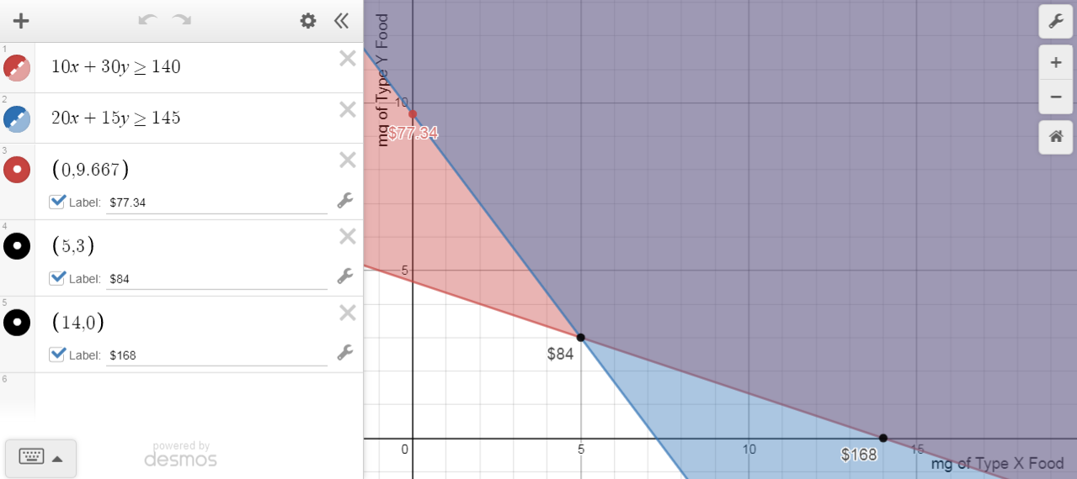

Slide 17
In your groups
Work on Woo’s Cookie Company Revisited.
X-number of plain cookies
Y-number of frosted cookies

Slide 18
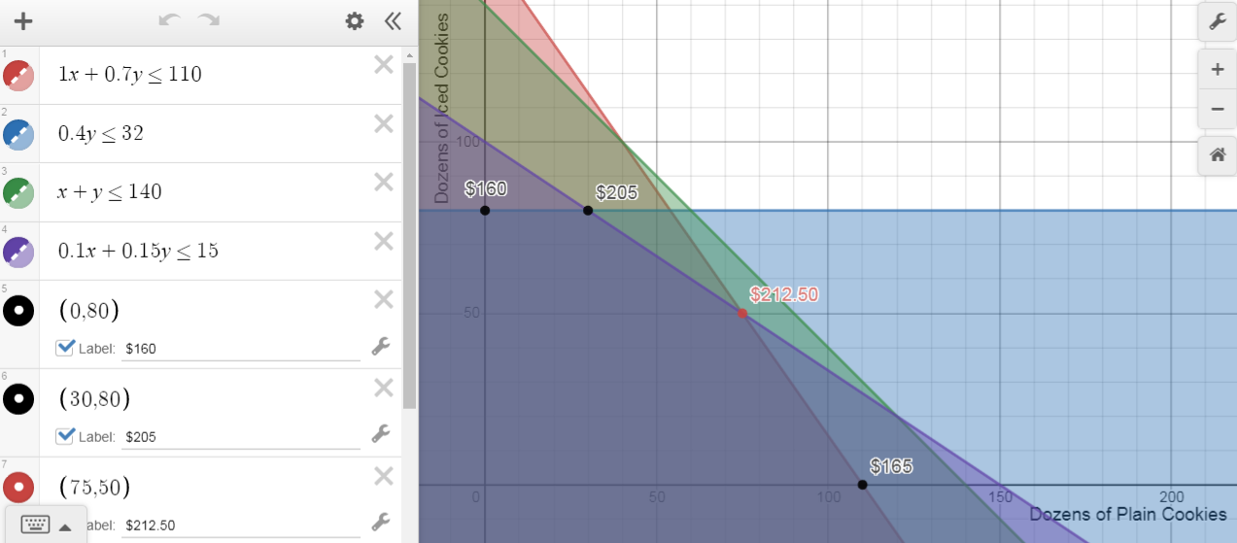

Slide 19
In your groups
Complete “BigStateU.”
X-Number of In-State Students
Y-Number of Out-of-State Students

Slide 20
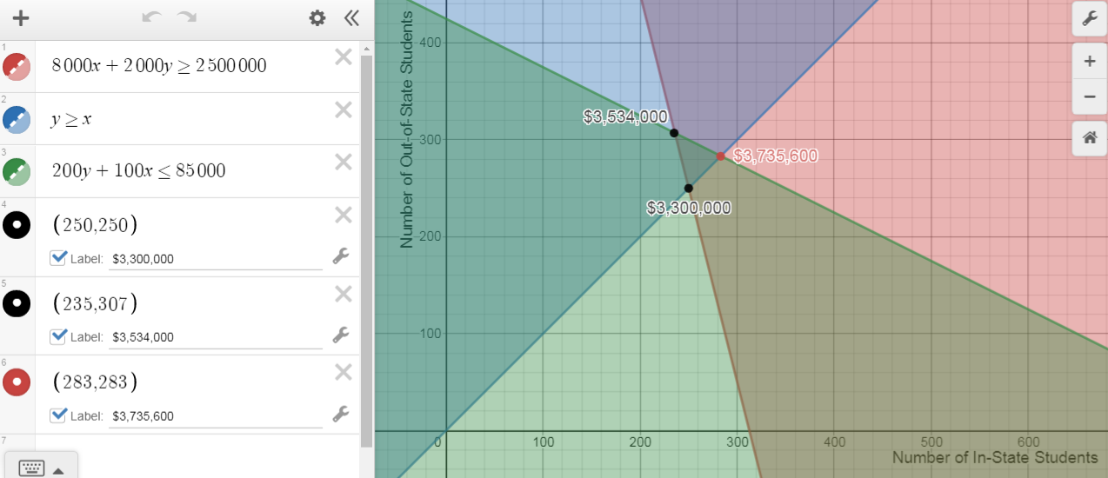

Slide 21
Let’s Revisit The Bouquet
Alex is ordering his girlfriend a bouquet of flowers to give her when he asks her to prom. Roses cost $5 each and carnations cost $2 each. He would like to include at least 3 flowers. To stay in his budget, he must not spend more than $36.
He wants to include at least 1 of each type of flower.
Finally, he wants to maximize the number of flowers in the bouquet so he doesn't appear cheap.
How many of each type of flower should he buy?

