Slide 1
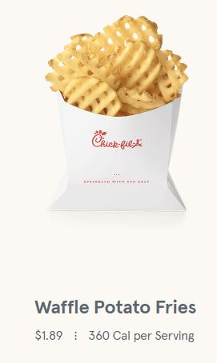
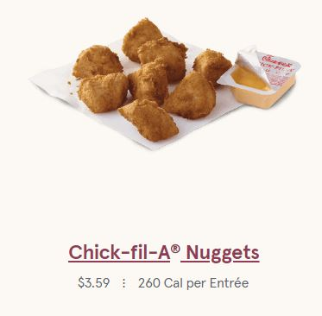
Your table has $20 to spend.
How much can you buy?
Come up with 2-3 options.
Notes:
Have students determine in groups of 2-3.
Add combinations (with cost) to board.

Slide 2
How can we represent this situation?
Let’s take a look!
Notes:
Graph on Desmos.

Slide 3
I’m Hungry!
I want at least 1 pack of fries and at least 2 packs of nuggets.
How do we represent that?
Notes:
Add to Desmos

Slide 4
Vocabulary
Constraint--limitation (represented with inequalities)
Feasible region--area of possible solutions (shaded area)

Slide 5
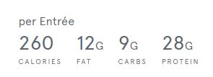
I want to avoid being hungry later...
What if I am limited by the number of calories, fat, protein, or carbs?
How do I calculate that?
Notes:
Create equation.
Discuss feasible region.

Slide 6
Each week, Carly can make 10 to 25 necklaces and 15 to 40 pairs of earrings. She earns profits of $3 on each pair of earrings and $5 on each necklace. From past sales, she anticipates selling at least 30 pieces of jewelry. She wants to make at least $30.

Slide 7
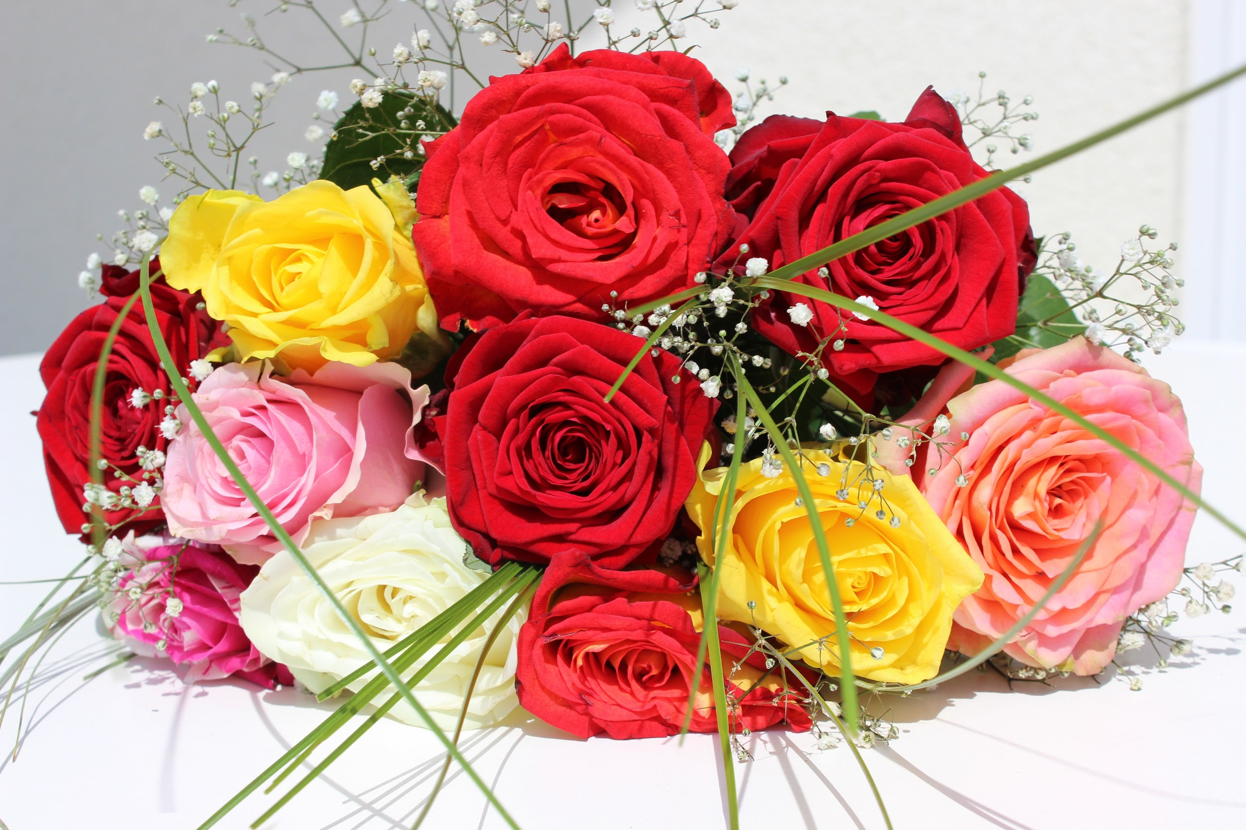
Let’s Revisit The Bouquet
Alex is ordering his girlfriend a bouquet of flowers to give her when he asks her to prom. Roses cost $5 each and carnations cost $2 each. He would like to include at least 3 flowers. To stay in his budget, he must not spend more than $36.
He wants to include at least 1 of each type of flower.

Slide 8
Prom
The Junior/Senior Prom Committee must consist of 5 to 8 representatives from the junior and senior classes. The committee must include at least 2 juniors and at least 2 seniors.

Slide 9
Simpler Cookie
Log into the chromebook and pull up the simpler cookie.

Slide 10
Your Business
Using your research, put constraints on what you can actually make.
You need to have at least 3 constraints for your two products.

Slide 11
Healthy Animals
Complete “Healthy Animals” for homework.

Slide 12
More Vocabulary
Optimization--seeking the maximum or minimum
Objective function--the function that we want to maximize or minimize
Vertex (or vertices)--where the lines touch
*Use the vertices of the feasible region to optimize!*

Slide 13
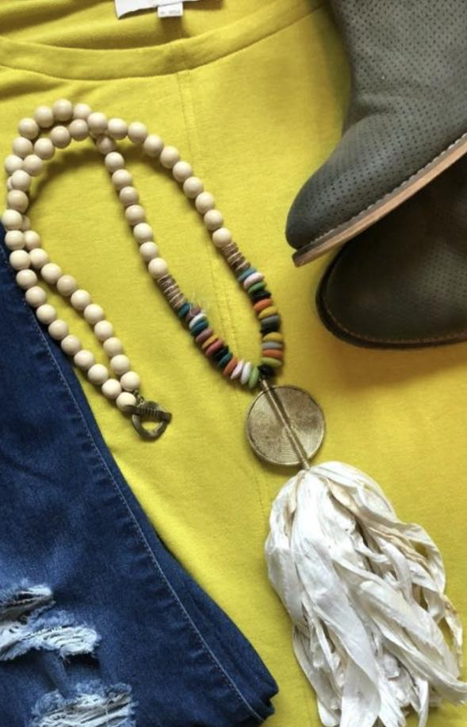
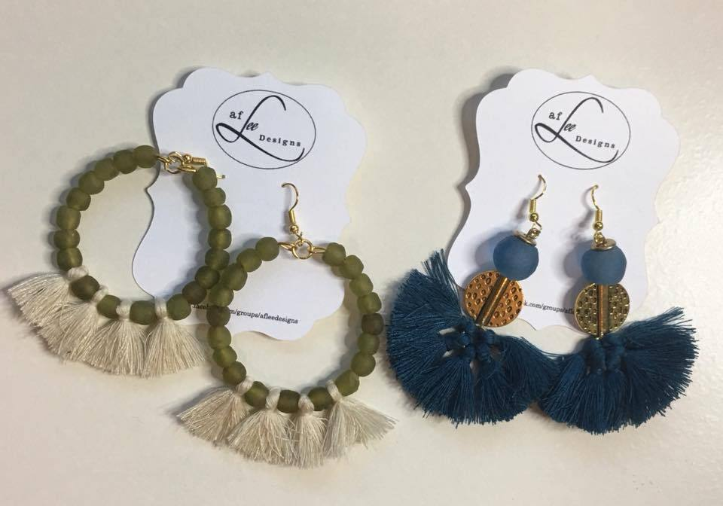
Remember My Neighbor?

Slide 14
Each week, Carly can make 10 to 25 necklaces and 15 to 40 pairs of earrings. She earns profits of $3 on each pair of earrings and $5 on each necklace. From past sales, she anticipates selling at least 30 pieces of jewelry. How can she maximize profit?

Slide 15
Let’s Revisit The Bouquet
Alex is ordering his girlfriend a bouquet of flowers to give her when he asks her to prom. Roses cost $5 each and carnations cost $2 each. He would like to include at least 3 flowers. To stay in his budget, he must not spend more than $36.
He wants to include at least 1 of each type of flower.
Finally, he wants to maximize the number of flowers in the bouquet so he doesn't appear cheap.
How many of each type of flower should he buy?

